Slide 1
Exception handling

Slide 2
Errors Vs Exceptions
What is an error?
An error is a term used to describe any issue that arises unexpectedly and results in incorrect output.
What are the different types of errors?
Logical error:
Occur due to poor understanding of problem or solution procedure.
Syntactic error:
Arise due to poor understanding of the language itself.
What is an exception?
Exceptions are run time anomalies or unusual conditions that a program may encounter while executing.

Slide 3
Exception Handling
Exceptions are of two types:
Synchronous exceptions
The exceptions which occur during the program execution due to some fault in the input data are known as synchronous exceptions.
For example: errors such as divide by zero
Asynchronous exceptions
The exceptions caused by events or faults unrelated (external) to the program and beyond the control of the program are called asynchronous exceptions.
For example: hardware malfunctions such as disk failure.

Slide 4
Exception Handling Mechanism
Exception handling mechanism provides a means to detect and report an exception circumstance.
Find the problem (Hit the exception)
Inform that an error has occurred (Throw the exception)
Receive the error information (Catch the exception)
Take corrective actions (Handle the exception)

Slide 5
Exception Handling Mechanism
The exception handling mechanism is built upon three keywords:
Try
Is used to preface a block of statements which may generate exceptions.
Throw
When an exception is detected, it is thrown using a throw statement in the try block.
Catch
A catch block defined by the keyword catch catches the exception thrown by the throw statement in the try block and handles it appropriately.

Slide 6
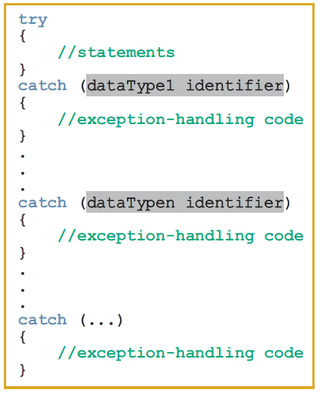
try/catch Block
The general syntax of a try/catch block is as follows:

Slide 7
Example - Division
#include <iostream>
using namespace std;
int main()
{
int dividend, divisor, quotient;
cout << "Enter the dividend: ";
cin >> dividend;
cout << endl;
cout << "Enter the divisor: ";
cin >> divisor;
cout << endl;
quotient = dividend / divisor;
cout << "Quotient = " << quotient<< endl;
return 0;
}
What if the divisor is zero?

Slide 8
Example – Throwing an exception
int main()
{
int dividend, divisor, quotient;
try //Line 2
{
cout << "Line 3: Enter the dividend: ";
cin >> dividend;
cout << endl;
cout << "Line 6: Enter the divisor: ";
cin >> divisor;
cout << endl;
if (divisor == 0)
throw divisor;
quotient = dividend / divisor;
cout << "Line 12: Quotient = " << quotient << endl;
}
catch (int x)
{
cout << "Line 14: Division by "<< x << endl;
}
return 0;
}
Sample Run 1:
Line 3: Enter the dividend: 9
Line 6: Enter the divisor: 3
Line 12: Quotient = 3
Sample Run 2:
Line 3: Enter the dividend: 5
Line 6: Enter the divisor: 0
Line 14: Division by 0

Slide 9
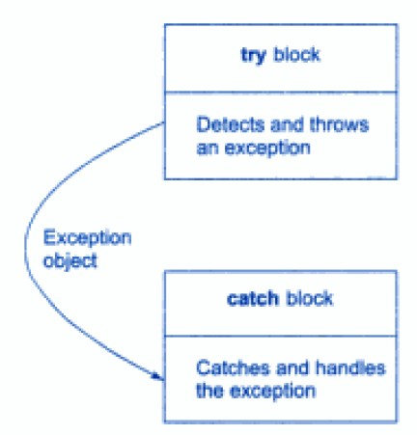
Exception Handling Mechanism
When the try block throws an exception the program control leaves the try block and enters the catch statement of the catch block
If the type of object thrown matches the arg type in the catch statement the catch block is executed.
Otherwise the program is terminated.

Slide 10
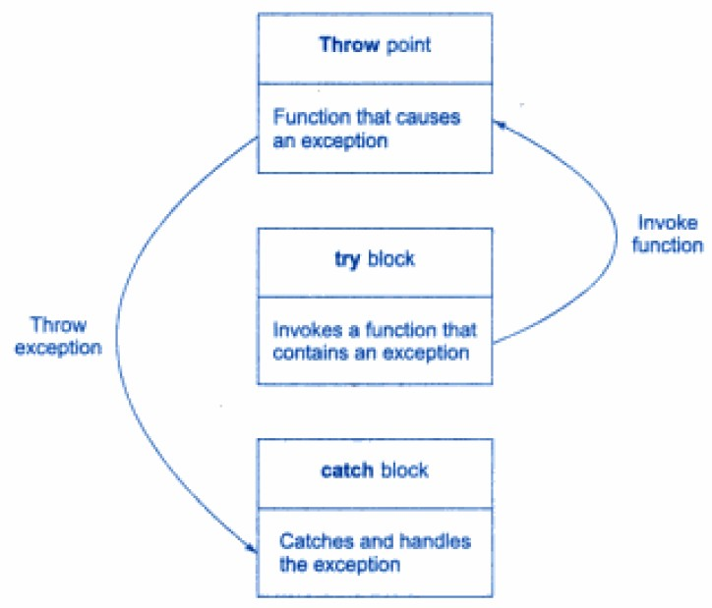
Exception thrown by functions
Mostly exception are thrown by functions that are invoked from within the try blocks.
The point at which the throw is executed is called the throw point.

Slide 11
Exception thrown by functions
#include<iostream>
using namespace std;
void divide(int x, int y, int z)
{
if((x-y) != 0)
{
int R = z/(x-y);
cout<<"Result = "<<R<<endl;
}
else
{
throw (x-y);
}
}
int main()
{
try
{
divide(10,20,30);
divide(10,10,20);
}
catch(int i)
{
cout<<"Exception caught"<<endl ;
}
return 0;
}
Output
Result = -3
Exception caught

Slide 12
Multiple catch statements
Multiple catch statements can be associated with a try block.
When an exception is thrown, then exception handlers are for an appropriate match.
The first handler that yields the match is executed.
After executing the handler, the control goes to the first statement after the last catch block for that try.

Slide 13
Multiple catch statements
int main()
{
int dividend, divisor = 1, quotient;
string inpStr = "The input stream is in the fail state.";
try
{
cout<<"Line 4: Enter the dividend: ";
cin>>dividend;
cout<<endl;
cout<<"Line 7: Enter the divisor: ";
cin>>divisor;
cout<<endl;
if (divisor == 0)
throw divisor;
else if (divisor < 0)
throw string("Negative divisor.");
else if (!cin)
throw inpStr;
quotient = dividend / divisor;
cout<<"Line 17: Quotient = "<<quotient<<endl;
}
catch (int x)
{
cout<<"Line 19: Division by"<<x<<endl;
}
catch (string s)
{
cout<<"Line 21: "<<s<< endl;
}
return 0;
} //end main
Sample Run 1
Line 4: Enter the dividend: 4
Line 7: Enter the divisor: 2
Line 17: Quotient = 2
Sample Run 2
Line 4: Enter the dividend: 6
Line 7: Enter the divisor: 0
Line 19: Division by 0
Sample Run 3
Line 4: Enter the dividend: .
Line 7: Enter the divisor:
Line 21: The input stream is in the fail state.

Slide 14
Catching all exceptions
Sometimes it is not possible to anticipate all possible types of exceptions and therefore not able to design independent catch handlers to catch them.
A catch statement can also force to catch all exceptions instead of a certain type alone.
Syntax
catch(...)
{
//statements for processing all exceptions
}

Slide 15
Catch all exceptions
int main()
{
int dividend, divisor = 1, quotient;
string inpStr = "The input stream is in the fail state.";
try
{
cout<<"Line 4: Enter the dividend: ";
cin>>dividend;
cout<<endl;
cout<<"Line 7: Enter the divisor: ";
cin>>divisor;
cout<<endl;
if (divisor == 0)
throw divisor;
else if (divisor < 0)
throw string("Negative divisor.");
else if (!cin)
throw inpStr;
quotient = dividend / divisor;
cout<<"Line 17: Quotient = "<<quotient<<endl;
}
catch (...)
{
cout<<"An Exception Occurred!"<<endl;
}
return 0;
} //end main
Sample Run 1
Line 4: Enter the dividend: .
Line 7: Enter the divisor:
An Exception Occured!
Sample Run 2
Line 4: Enter the dividend: 6
Line 7: Enter the divisor: 0
An Exception Occured!

Slide 16
Re-throwing an Exception
A handler can re-throw the exception caught without processing it.
This can be done using throw without any arguments.
Here the current exception is thrown to the next enclosing try/catch block.
Every time when an exception is re-thrown it will not be caught by the same catch statements rather it will be caught by the catch statements outside the try catch block.

Slide 17
Re-throwing an Exception
#include<iostream>
using namespace std;
void divide(double x, double y)
{
cout<<"Inside Function: ";
try
{
if(y == 0.0)
throw y;
else
cout<<"Division = "<<x/y<<endl;
}
catch(double)
{
cout<<"Caught double inside function"<<endl;
throw;
}
cout<<"End of function"<<endl;
}
int main()
{
cout<<"Inside main"<<endl;
try
{
divide(10.5, 2.0);
divide(20.0, 0.0);
}
catch(double)
{
cout<<"Caught double main"<<endl;
}
cout<<"End of main"<<endl;
return 0;
}
Output:
Inside main
Inside Function: Division = 5.25
End of function
Inside Function: Caught double inside function
Caught double main
End of main

Slide 18
Using C++ Exception classes
C++ provides support to handle exceptions via a hierarchy of classes.
The class exception is the base of the classes designed to handle exceptions.
Among others, this class contains the function what.
The function what returns a string containing an appropriate message.
All derived classes of the class exception override the function what to issue their own error messages.

Slide 19
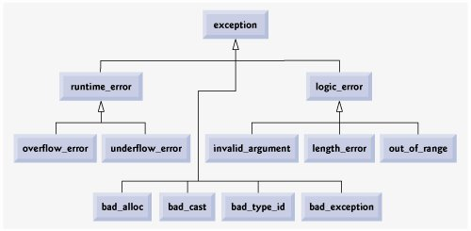
The C++ Exception hierarchy

Slide 20
Using C++ Exception classes
#include <iostream>
using namespace std;
int main()
{
string sentence;
string str1, str2, str3;
try
{
sentence = "Testing string exceptions!";
cout << "Line 5: sentence = " << sentence << endl;
cout << "Line 6: sentence.length() = "
<< sentence.length() << endl;
str1 = sentence.substr(8, 18);
cout << "Line 8: str1 = " << str1 << endl;
str2 = sentence.substr(28, 10);
cout << "Line 10: str2 = " << str2 << endl;
str3 = "Exception handling. " + sentence;
cout << "Line 12: str3 = " << str3 << endl;
}
catch (out_of_range re)
{
cout << "Line 14: In the out_of_range "
<< "catch block: " << re.what()
<< endl;
}
} //end of main
Output
Line 5: sentence = Testing string exceptions!
Line 6: sentence.length() = 26
Line 8: str1 = string exceptions!
Line 14: In the out_of_range catch block: basic_string::substr: __pos (which is 28) > this->size() (which is 26)

Slide 21
Creating your own Exception Classes
C++ provides numerous exception classes to deal with different type of situations.
Does not provide all of the exception classes you will every need.
C++ enables programmers to write their own exception classes.
For exceptions not covered by C++ exception classes
And their own exceptions.
In C++ any class can be considered as an exception class.

Slide 22
Creating your own Exception Classes
class divisionByZero
{
private:
string message;
public:
divisionByZero()
{
message = "Division by zero";
}
divisionByZero(string str)
{
message = str;
}
string what()
{
return message;
}
};
void doDivision() throw (divisionByZero)
{
int dividend, divisor, quotient;
cout<<"Line 8: Enter the dividend: ";
cin>>dividend;
cout<<endl;
cout<<"Line 11: Enter the divisor: ";
cin>>divisor;
cout<<endl;
if (divisor == 0)
throw divisionByZero("Found division by 0!");
quotient = dividend / divisor;
cout<<"Line 17: Quotient = "<<quotient<<endl;
}
int main()
{
try
{
doDivision();
}
catch (divisionByZero divByZeroObj)
{
cout<<"Line 4: In main: "<<divByZeroObj.what()<<endl;
}
return 0;
}
Sample Run 1
Line 8: Enter the dividend: 6
Line 11: Enter the divisor: 3
Line 17: Quotient = 2
Sample Run 2
Line 8: Enter the dividend: 4
Line 11: Enter the divisor: 0
Line 4: In main: Found division by 0!

Slide 23
Exception Handling Techniques
When an exception occurs, the programmer usually has three choices:
Terminate the Program
In some cases when an exception occurs, it is best to let the program terminate.
e.g. a program that reads input from a file. If the input file does not exist.
Fix the Error Continue
In some cases you will want to handle the exception and let the program continue.
e.g. if a user enters 0 as a divisor in a divide operation. Prompt the user to input again or show an error and continue.
Log the Error and Continue

Slide 24
thanks

